Slide 1
Neural Network for Wildfire Detection: a VHDL approach
Bachelor Thesis
Constantinos Dionysiou
Cyprus University of Technology
Department of Electrical Engineering

Slide 2
FPGA implementation, neural networks, nonlinear systems
Artificial neural networks (ANNs) are selected for their adaptability, which enables them to analyze diverse data quickly through network parallelism.
Given these unique characteristics of ANNs, the customizable nature of FPGAs (field programmable gate arrays) makes them an intriguing option for a hardware implementation. Therefore, even if FPGAs have poorer performance than VLSI (Very Large Scale Integration) circuits, it is still possible to change an ANN's features or structure without rebuilding the circuit. Additionally, FPGAs have rapid design cycles and are inherently parallel.

Slide 3
Problem Definition
The problem of real-time wildfire indication by using RGB video streams, with per-pixel classification performed at full video frame rate. The system is designed to operate entirely at the edge, without relying on cloud infrastructure or GPU (Graphical Processing Unit) acceleration.
The overall goal is to achieve high throughput with low power consumption, enabling reliable and responsive wildfire detection in practical deployments.
Notes:
Clarify that each pixel is classified in real time using FPGA hardware.

Slide 4
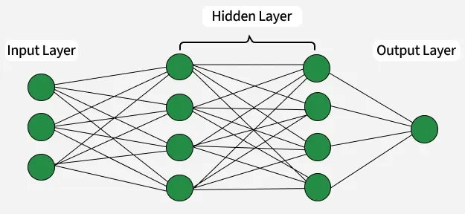
What is neural network?
Neural networks are machine learning models composed of interconnected nodes or neurons that process information, identify patterns, and facilitate tasks such as decision-making and pattern recognition.
Networks are built from several key components:
Neurons: The basic units that receive inputs, each neuron is governed by a threshold and an activation function.
Connections: Links between neurons that carry information, regulated by weights and biases.
Weights and Biases: These parameters determine the strength and influence of connections.
Propagation Functions: Mechanisms that help process and transfer data across layers of neurons.

Slide 5
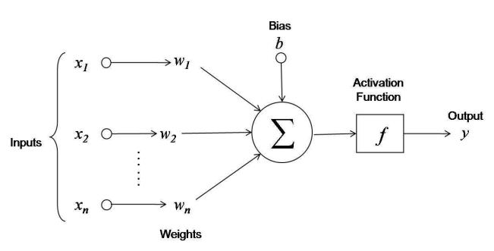
Neuron the output y=f(Xi*Wi+b)
Linear Transformation: Inputs are multiplied by the weights connected to each neuron in a layer. After adding a bias to the total, these products are totaled. This can be expressed numerically as: z=w1​x1​+w2​x2​+…+wn​xn​+b
where
W:represents the weights
X: represents the inputs
b: is the bias

Slide 6
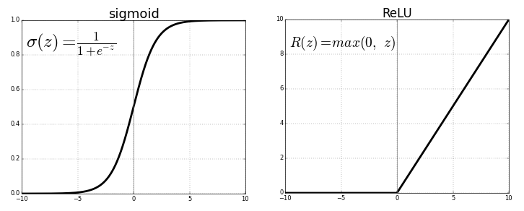
Activation functions
2. Activation: The result of the linear transformation (denoted as z) is then passed through an activation function. The activation function is crucial because it introduces non-linearity into the system, enabling the network to learn more complex patterns. Popular activation functions include ReLU (Rectified Linear Unit) and sigmoid.

Slide 7
Backpropagation
Following forward propagation, the network uses a loss function to quantify the discrepancy between the actual and expected outputs, assessing its performance. Reducing this loss is the aim of training.
Loss Calculation: The network determines the loss, which gives an indication of the prediction error.
Gradient Calculation: The network calculates the gradients of the loss function in relation to each network weight and bias.
Weight Update: After the gradients are computed, an optimization procedure such as stochastic gradient descent (SGD) is used to update the weights and biases.

Slide 8
Iteration
Forward propagation, weight updating, backpropagation, and loss computation are all repeated numerous times across the dataset. This iterative approach gradually lowers the loss and improves the accuracy of the network's predictions.
Neural networks can perform better on tasks like classification, regression, and other predictive modeling by adjusting their parameters to more accurately represent the relationships in the data.

Slide 9
Refinement
Early wildfire indication directly from a live video stream by performing low-latency, low-power per-pixel classification on an FPGA is targeted. - wildfires cause severe environmental and economic damage -early detection is essential to minimizing their spread.
Compared to cloud-based or GPU-based AI solutions, an FPGA edge implementation can avoid the high latency and power draw that often limit real-time deployment.

Slide 10
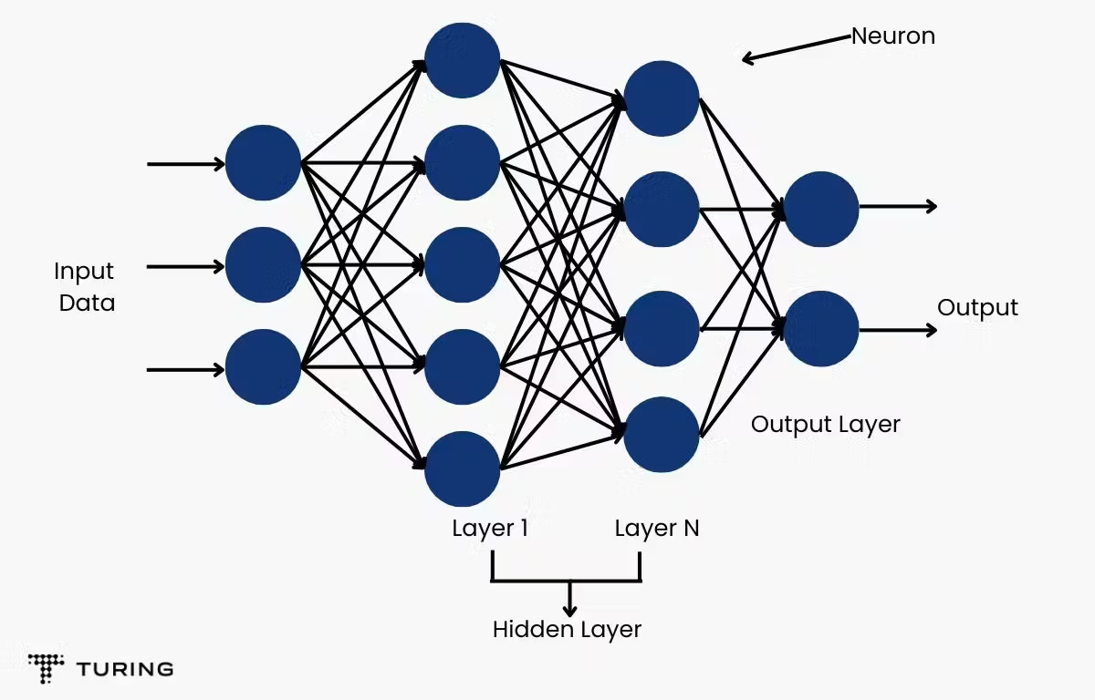
architecture
The architecture used is a 3–7–2 Multi Layer Perceptron (MLP) in Python for training and then in VHDL for inference
class MLP:
def __init__(self, in_dim, hidden, out_dim, act="sigmoid"):
rng = np.random.default_rng(42)
self.W1 = rng.normal(0, 0.2, (hidden, in_dim)).astype(np.float32)
self.b1 = np.zeros((hidden,), dtype=np.float32)
self.W2 = rng.normal(0, 0.2, (out_dim, hidden)).astype(np.float32)
self.b2 = np.zeros((out_dim,), dtype=np.float32)
self.act = sigmoid if act == "sigmoid" else relu
def forward(self, x):
h = self.act(x @ self.W1.T + self.b1)
z = h @ self.W2.T + self.b2
return z, h

Slide 11
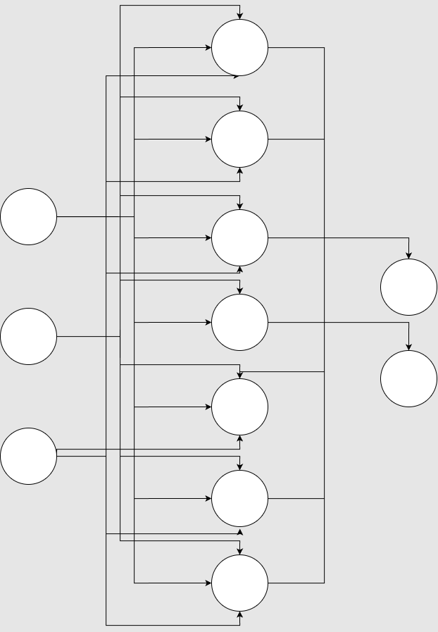
Neural Network Topology and Quantization
Fixed-point design:
- Inputs: 8-bit RGB (0..255) normalized in integer domain
- Weights/bias: signed ints (exported from Python)
- Activation: 12-bit address -> 8-bit output ROM (sigmoid Look Up Table - LUT)
- Total params: 44 ints (3x7 + 7 bias + 7x2 + 2 bias)

Slide 12
Fixed-Point and LUT Activation
Weights/bias quantized to integers, packed in VHDL arrays
Sigmoid implemented as ROM (12-bit address)
Neuron pipeline: parallel multipliers + accumulator + LUT

Slide 13
Dataset and Sampling
Source: wildfire images + segmentation masks (where available)
Per-image random pixel sampling; balanced pos/neg when mask exists
Features: raw RGB (8-bit each); Labels: fire vs not-fire

Slide 14
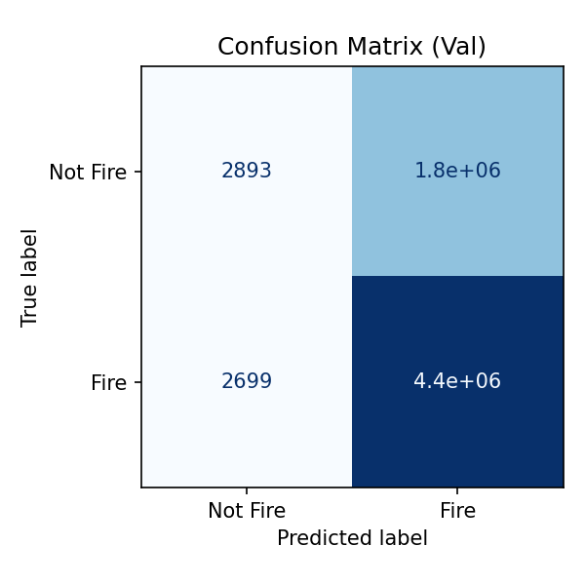
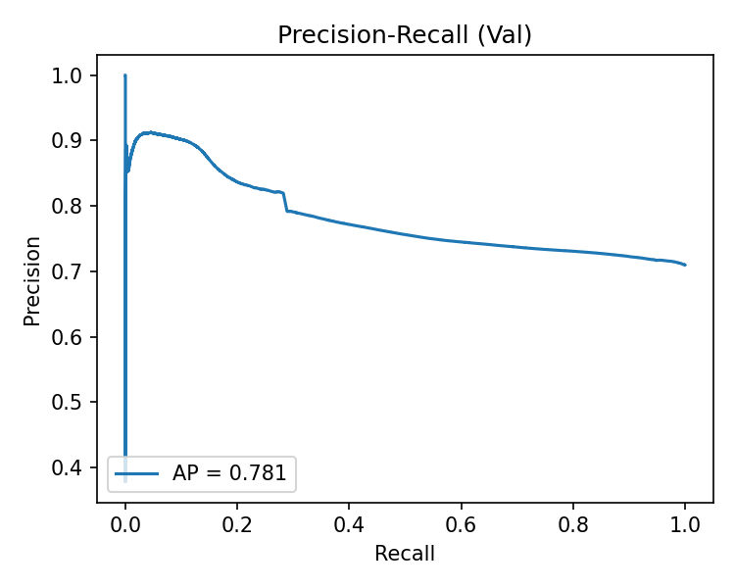
Experimental Results
Software evaluation

Slide 15


Dataset Examples
Fire
Not Fire

Slide 16

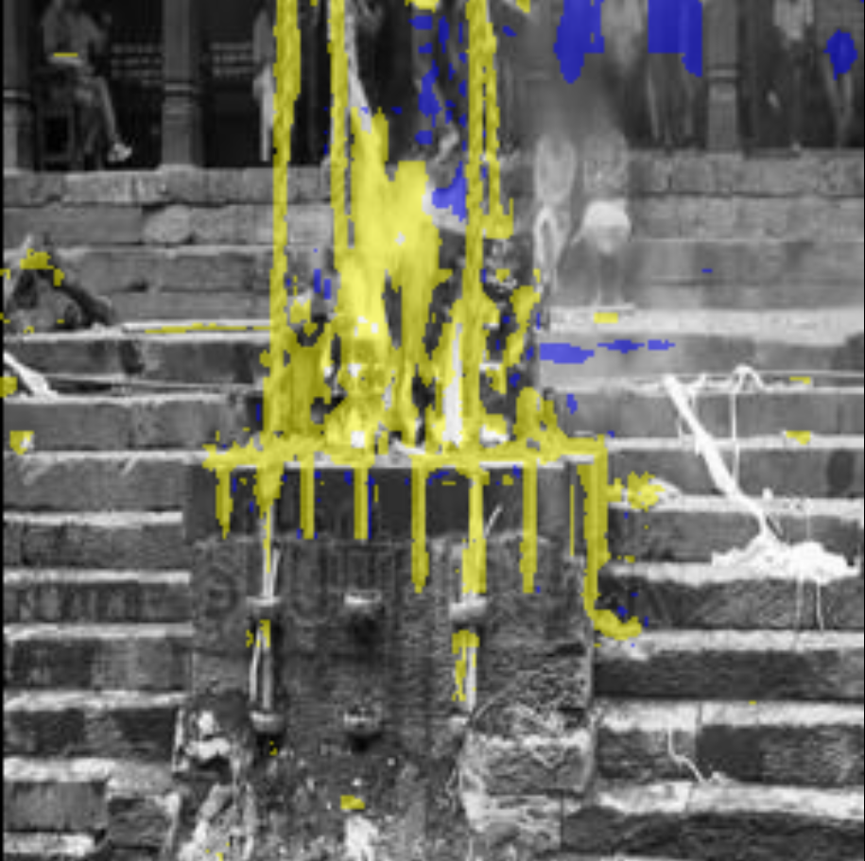
Simulation Output
Offline accuracy on held-out pixels 79.7% (val split 20%)

Slide 17
Hardware implementation
After the training is completed in Python, the parameters are exported as a table where the values are inserted later as fixed values in vhdl.
The architecture does not change, it is just implemented in hardware.
The hardware does not change the values of the parameters, it is only for inference.

Slide 18
FPGA Top-Level Processing Chain
Video Rx
PCLK, HS/VS/DE
RGB888
Pre-Scale /
Clamp
MLP 3–7–2
fixed-point
Sigmoid LUT
ROM 4k×8
Classify /
Overlay
Video Tx
Data path: per-pixel inference at pixel clock. One-cycle ROM latency. Pipelined MACs in neuron array.

Slide 19
Key RTL Modules (nn_rgb.vhd)
control.vhd: sync/enable, pipeline alignment
neuron.vhd: MAC tree per neuron with final bias add
multiplier.vhd: per-input multiply (inferred DSP)
sigmoid_IP.vhd: ROM-based LUT (Xilinx BRAM / Intel M9K)

Slide 20
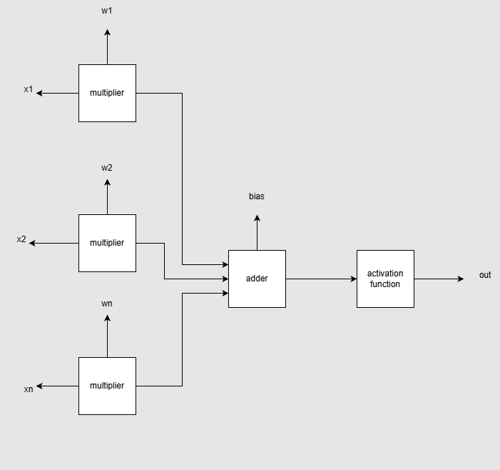
The neuron
The neuron takes the X inputs, multiplies them by the corresponding weights, and then adds them all up, including a bias value.
The output goes into the activation function component, which is created as a ROM.

Slide 21
Hardware Platforms
Xilinx ML501 (Virtex-5): DVI Rx/Tx available, JTAG/SystemACE config
Intel Cyclone V path exists (Quartus 13.0 SP1), no native video Rx
Zynq ultrascale + MPSoCs (only on vivado)
Design is vendor-neutral except sigmoid ROM wrapper

Slide 22
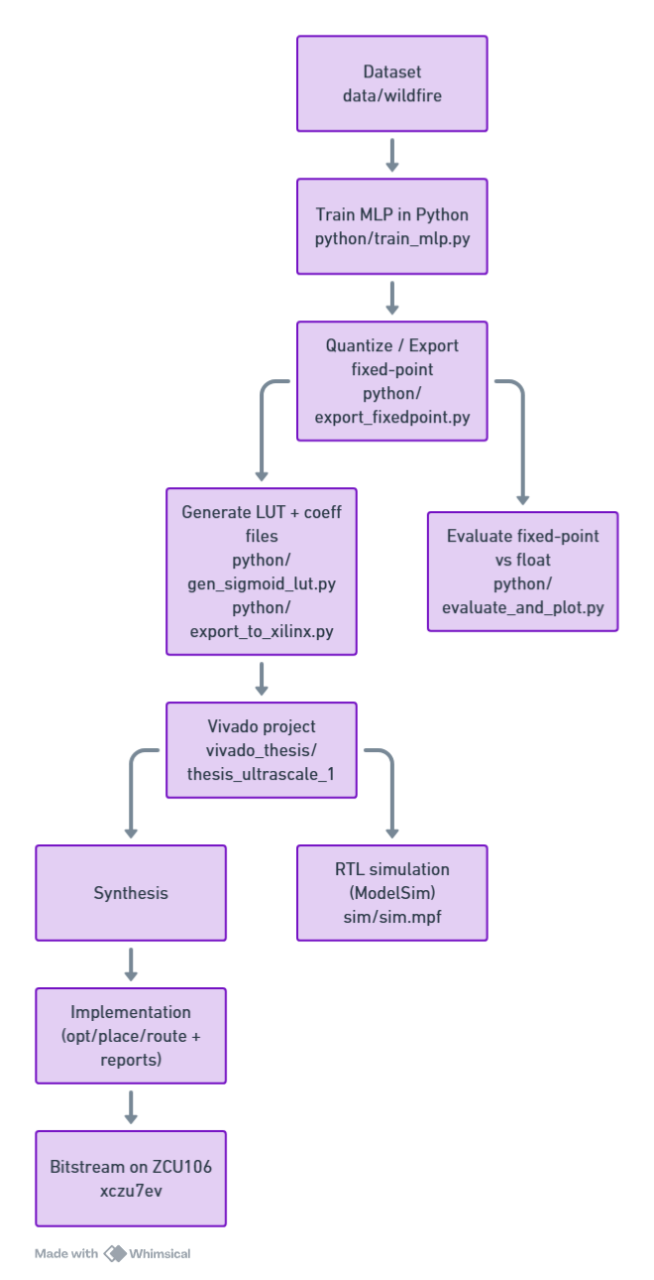
End-to-end workflow
Data and training (Python)
Dataset in wildfire (image and mask folders).
Train MLP and produce floating-point weights/biases using train_mlp.py.
Quantize to fixed-point and export artifacts using:
export_fixedpoint.py: converts trained tensors to fixed-point.
gen_sigmoid_lut.py: generates activation LUT samples.
export_to_xilinx.py: writes COE and optionally a VHDL package.
Config drives sizes/bitwidths via config.yaml.
Outputs:
Fixed-point arrays in artifacts and text/COE files in coeffs:
weights_layer1.txt, bias_layer1.txt
weights_layer2.txt, bias_layer2.txt
activation_lut.txt and activation_lut.coe

Slide 23
Functional validation (Python)
Compare fixed-point inference vs. floating-point using evaluate_and_plot.py and test vectors in testvectors.
RTL simulation (ModelSim/Questa)
Project file sim.mpf compiles the same VHDL sources used by Vivado. It also contains references to stimulus/response images: image_stimuli.ppm, image_response.ppm.
Synthesis and implementation (Vivado 24.1.2, ZCU106)
Python side (how parameters become hardware-initialized constants)
Sigmoid LUT COE:
export_to_xilinx.py loads activation_lut.txt and emits activation_lut.coe via its local function write_coe(...).
Weights/Biases:
Stored as text files in coeffs. These are typically converted to either a VHDL package with constant arrays or to additional ROM initializations.

Slide 24
VHDL design overview
Source files: VHDL
Top: nn_rgb
Control FSM: control
Compute blocks: neuron, multiplier
Activation: sigmoid_IP, sigmoid_lut
Configuration/constants: config
Simulation/test: sim_nn_rgb, tb_nn_rgb
Data path
Pixels (RGB) or features are ingested by nn_rgb.
Layer 1: parallel MACs using multiplier accumulate weighted sums inside neuron, add bias, then apply activation via sigmoid_IP which internally uses a ROM sigmoid_lut initialized by activation_lut.coe.
Layer 2: repeats MAC + activation to produce output probability(ies).
control sequences valid/ready, input loading and layer enable.

Slide 25
config
Purpose: centralizes generics/constants, e.g., number of inputs/neurons/layers, fixed-point width Qm.n, LUT size, address widths.
multiplier
Purpose: fixed-point signed multiply with optional rounding/saturation and a pipeline register to map onto DSP slices in UltraScale+.
Role: building block for MAC inside a neuron.
neuron
Purpose: compute y=σ(∑iwixi+b)y=σ(∑i​wi​xi​+b) in fixed-point.
Internals:
A generate loop of multiplier instances for wi*xi​.
An adder tree/accumulator to sum products.
Bias add, optional saturation, and handoff to activation.
Interfaces: vector input, weight/bias inputs (from constants or ROM), valid/ready or start/done signals.

Slide 26
sigmoid_IP
Purpose: activation function via lookup. Converts fixed-point input to LUT address, reads from BRAM/ROM.
Internals: address scaling/clamping + instance of sigmoid_lut whose INIT is driven by activation_lut.coe.
sigmoid_lut
Purpose: the ROM primitive or inferred ROM for the LUT samples.
Note: synthesized into BRAM on Zynq UltraScale+ with COE init.
control
Purpose: FSM for sequencing the NN:
Load inputs for layer 1
Start MACs, wait for activation latency
Feed layer 2
Output valid flag and result
Interfaces: clock/reset, input stream (pixels or features), start/valid/ready, and status outputs.

Slide 27
nn_rgb
Purpose: top-level; instantiates control + arrays of neurons for each layer + sigmoid IP; wires constants from config; exposes the top I/O.
Role: integration point used as the synthesis top in Vivado TCL scripts.
Testbenches
sim_nn_rgb, tb_nn_rgb read image_stimuli.ppm and compare to image_response.ppm or golden vectors in testvectors.

Slide 28
Data path
Ingress (per clock):
Top entity nn_rgb exposes video ports:
Inputs: vs_in, hs_in, de_in, r_in[7:0], g_in[7:0], b_in[7:0]
Outputs: vs_out, hs_out, de_out, r_out[7:0], g_out[7:0], b_out[7:0]
On each clk, when de_in = '1', the 8‑bit r_in/g_in/b_in samples are registered and forwarded as feature inputs to the first-layer MACs.
Control/timing alignment:
The controller gates “pixel valid” into the compute path and delays vs/hs/de to align with the NN latency, so output timing matches the corresponding processed pixel.

Slide 29
Compute:
Layer MACs multiply each incoming feature by fixed weights using the multiplier, sum inside the neuron, add bias, then apply activation in sigmoid_IP, which reads the LUT ROM sigmoid_lut initialized by activation_lut.coe.
Fixed‑point scaling follows the project’s Qm.n settings from config (inputs are interpreted in that format; arithmetic is scaled by the NN result is mapped to r_out/g_out/b_out (and de_out/hs_out/vs_out are the delayed timing), ready for downstream video.

Slide 30
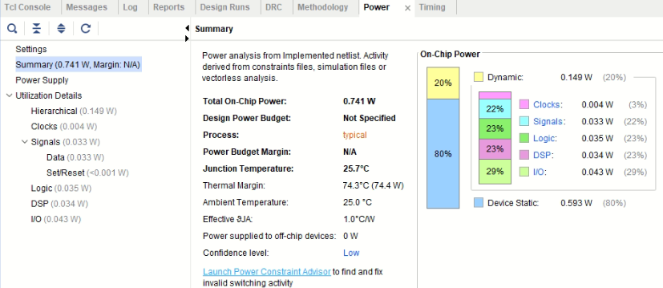
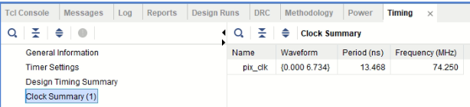
Resource and Timing

Slide 31
Limitations and Future Work
Training and inference on a single device without software is limited, despite the flexibility and inheritance of parallelism on FPGAs. The backpropagation modules and data chain can be implemented in terms of area and resource usage.
Additionally, even though pattern recognition is effective, more work is required to expand the architecture or add convolution layers. Decision-making and feature selection might benefit from greater research since more variables can address issues in real time during a wildfire.

Slide 32
Conclusion
This project's goal was to create a VHDL model of an artificial neural network for the purpose of determining the system's functions and creating modules to carry them out comprised the initial work.
The modules' timing behavior and functioning were properly confirmed. Additionally, the model was developed using VHDL for inference and Python programming for training.
Using FPGA, we take advantage of the high speeds achievable using hardware, and as a result, it is a beneficial and economic investment for designs requiring artificial Neural Networks.
In conclusion, this work demonstrates that low-latency wildfire indication on an FPGA is feasible and efficient.

